Slide 1

Zero Trust Protection Use Cases
Explore practical applications and benefits of Zero Trust security, with guidance from Cisco Zero Trust Solutions for modern enterprises.
YN
Your Name
2026-02-19
Notes:
This slide introduces the focus on Zero Trust security use cases, emphasizing how Cisco Zero Trust Solutions can address enterprise security needs with practical, actionable strategies.

Slide 2
Introduction to Zero Trust
1
1
Every device and user treated as unknown by default
Never trust, always verify as core approach
2
Each access requires authentication and validation
Notes:
Zero Trust is a security strategy where no user or device is trusted automatically. Every access request is verified and authenticated, regardless of location or credentials, as a central approach to improving security.

Slide 3

Introduction to Zero Trust
Zero Trust is a modern security model requiring continuous verification for every access request, no matter the user’s location or device.
Never Trust, Always Verify
All access requests must be verified and authorized, enforcing strict identity checks at every step.
Beyond Perimeter Security
Moves away from relying solely on traditional network boundaries by tightly managing user access everywhere.
Notes:
Zero Trust changes traditional security by focusing on constant verification. It doesn’t assume anything inside or outside a network is safe, but checks access at every point, minimizing risk.

Slide 4

Why Embrace Zero Trust?
Hybrid Work Is Here to Stay
Secure BYOD & Unmanaged Devices
Combat Modern Threats
Protects against ransomware and supply chain breaches by verifying users and devices at every access point.
Employees access company resources from any location, making traditional perimeter-based security insufficient.
Enables secure access for personal and unmanaged devices without complex endpoint control measures.
Notes:
As hybrid work environments and device diversity become the norm, traditional security perimeters are no longer effective. Zero Trust addresses these challenges by ensuring every connection is verified, combating emerging threats such as ransomware and compromised third-party access.

Slide 5

Core Zero Trust Principles
Least-Privileged Access
Continuous Verification
Adaptive Security
Restrict access for users and applications to only what is strictly necessary, minimizing security risks from excessive permissions.
Regularly authenticate users and monitor activity to ensure ongoing trust and timely detection of anomalies.
Implement dynamic, risk-aware controls that adjust access based on real-time context and behavior.
Threat Intelligence Integration
Leverage threat data to strengthen security controls and respond proactively to emerging risks.
Notes:
Zero Trust is built on granting minimal, necessary access, ensuring ongoing authentication, adapting controls based on current risk, and using threat intelligence to improve security posture.

Slide 6

Zero Trust Remote Access
1
Direct App Connections
2
Encrypted Data Transport
Direct-to-application links bypass legacy backhaul, improving performance and reducing exposure.
TLS/IPsec tunnels safeguard data in transit, ensuring confidentiality and compliance.
3
Low-Latency Global Access
4
Resilient Architecture
Multiple worldwide PoPs enable efficient, low-latency routing for remote users.
Automatic failover and high availability maintain continuous secure access.
graph TD; A[Start]-->B{Choice}; B-->C[Path 1]; B-->D[Path 2];
Notes:
Zero Trust secure remote access enables direct application connectivity, eliminates traditional network bottlenecks and backhauling, and leverages global PoPs for reliable, low-latency experiences. Data security is maintained through robust encryption, while high-availability design ensures users always stay connected.

Slide 7
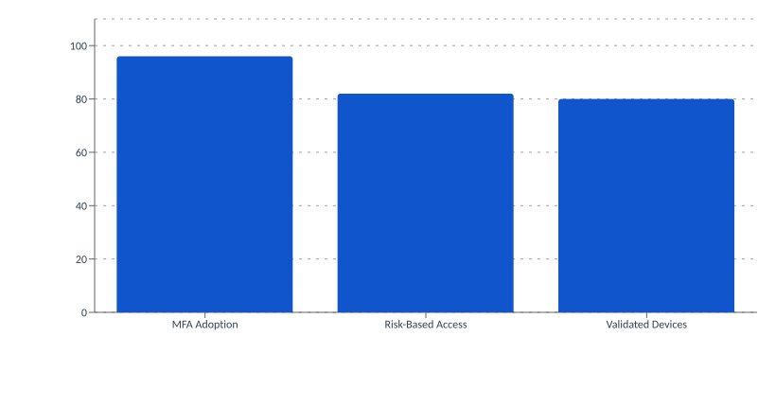
Zero Trust in Identity & Access Management
Adaptive MFA
Automatically adjusts authentication requirements based on user context and risk.
Risk Scoring
Leveraging adaptive MFA, risk access scoring, device validation, and ITDR for secure, seamless access.
Access decisions use real-time risk scores for each session.
100
Device Validation
80
Ensures only compliant and secure devices can access resources.
60
40
Continuous Monitoring
Watches user activity throughout each session for ongoing security.
20
0
MFA Adoption
Risk-Based Access
Validated Devices
ITDR Integration
Links identity with threat detection for faster incident response.
Notes:
This approach strengthens identity controls using adaptive MFA, real-time risk scoring, device validation, and session monitoring. The result is strong adoption, improved access security, and enhanced threat response.

Slide 8
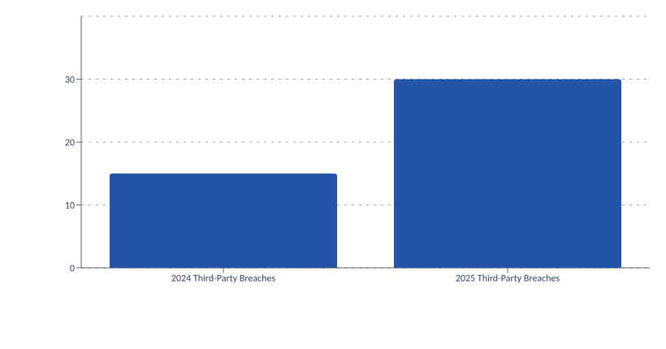
Zero Trust: Securing Third-Party & BYOD Access
Endpoint Interrogation
VPNs verify endpoint security posture before granting network access.
Agentless Options
Agentless and lightweight solutions enhance visibility for unmanaged devices.
With rising threats from unmanaged access points, adopting Zero Trust approaches mitigates growing risks linked to third-party and BYOD connections.
Notable Breaches
High-profile cases, like Uber 2022, highlight the risks of insufficient controls.
30
20
10
0
2024 Third-Party Breaches
2025 Third-Party Breaches
Notes:
Third-party and BYOD access presents an increasing risk for data breaches, as seen in recent statistics and cases like Uber. Utilizing Zero Trust, including VPN endpoint checks and agentless solutions, helps maintain control over these complex environments and reduces exposure.

Slide 9

Zero Trust in Threat Detection
1
Risk-Based Dynamic Access
2
Automated Threat Response
Access decisions adapt in real time to user behavior and live threats, minimizing risks.
System rapidly identifies and mitigates threats using automation for swift containment.
3
Threat Intel Integration
Enforcement points leverage intelligence feeds to proactively shrink the attack surface.
graph TD; A[Start]-->B{Choice}; B-->C[Path 1]; B-->D[Path 2];
Notes:
This slide presents how Zero Trust enables dynamic, context-aware access and automated responses by integrating threat intelligence directly at enforcement points, enhancing organizational security while proactively diminishing attack vectors.

Slide 10



Zero Trust Use Case: Application & Network Visibility
App Coverage
Net Issues Reduced
Cloud Sites
99%
75%
140+
End-to-end monitoring across network, app, and cloud environments
Enhanced visibility for hybrid and multi-cloud architectures
Actionable insights to quickly identify and resolve issues
Notes:
Cisco ThousandEyes delivers robust visibility for both applications and networks across hybrid and cloud environments. This capability helps organizations monitor end-to-end performance, proactively identify disruptions, and optimize both user experience and operational reliability.

Slide 11
Authentication Methods in Zero Trust
1
Passwords, PINs, security questions for identification
2
Devices like mobile phones, tokens, or smart cards
3
Biometric data such as fingerprints and facial recognition
Notes:
Zero Trust authentication uses several methods: knowledge-based (passwords, PINs), possession-based (mobile phones, tokens), and biometric-based (fingerprints, facial recognition). Combining these strengthens security and minimizes the risk of unauthorized access.

Slide 12
Overcoming Challenges
Access Security
Cisco’s unified strategy reduces access complexity and minimizes device fragmentation for BYOD and external users.
Notes:
Cisco streamlines managing diverse devices and users by uniting multiple access controls, making it easier to maintain security and consistency without excessive complexity.

